Slide 1


DEPARTMENT OF INFORMATION TECHNOLOGY
V R SIDDHARTHA ENGINEERING COLLEGE
Avantel Project
Health Care Management System
Domain : Health Care
B.Tech in INFORMATION TECHNOLOGY
MINI Project Review Presentation
Presented by :
RIZWANULLAH MD ( 208W1A1299 )
SRI SASHANK P ( 208W1A12B3 )
Under the guidance of
M RAMESH Asst Prof

Slide 2
AGENDA
Problem Statement
Abstract
Objectives and Outcomes
Requirements of Project
Literature review

Slide 3
PROBLEM STATEMENT
To develop a Web application and Mobile application to provide health care services for Patients, Doctor’s,Pharmacists and Lab operators.

Slide 4
ABSTRACT
The project aims to develop a comprehensive healthcare management system through the creation of a mobile application and a website. The system will streamline and improve the healthcare experience for users by providing various features such as appointment scheduling, symptom checker, and access to medical records.
The goal is to enhance the efficiency of healthcare delivery and make it more accessible and convenient for patients.

Slide 5
OBJECTIVES
PHASE-1: Developing the website for the Health Care Management System.
PHASE-2: Developing mobile application for the Health Care Management System.
PHASE-3:
  Apply Authentication & Security in Web application and Mobile application. Identify and handle OWASP API Security Top 10 Vulnerabilities 2019 in APIs exposed by the web application.
  Implement TLS v1.2 in APIs for securing data transfer between web server and mobile/web application. Implementation of logging and registration for all users in the proposed system. Design registrations, schedules, calendars, e-prescription through dashboard.

Slide 6
OUTCOMES
Web Application and Mobile App for both operating systems (Ios & Android ) where users can consult a doctor via text ( or ) voice ( or ) video by scheduling an appointment before hand.
Patients are able to easily book lab tests and medicines prescribed by doctor.
It has e-prescription of doctor which will be easy for pharmacists.

Slide 7
REQUIREMENTS OF PROJECT
Front End
Software Requirements
HTML5
CSS3
JavaScript
Angular
VsCode
Android Studio
Windows & Kali OS
Back End
Mobile App
NodeJS
ExpressJS
MongoDB database
Kotlin ( or ) React Native

Slide 8
LITERATURE REVIEW
These applications provides health care services
PRACTO APP:
24/7 doctor consultations
Booking appointments and lab tests
Digital prescription
FAMILY DOCTOR APP:
Book appointments
Add them to your calendar
Get reminders
Online check-in and queue information
Important health updates

Slide 9
THANK YOU

Slide 10
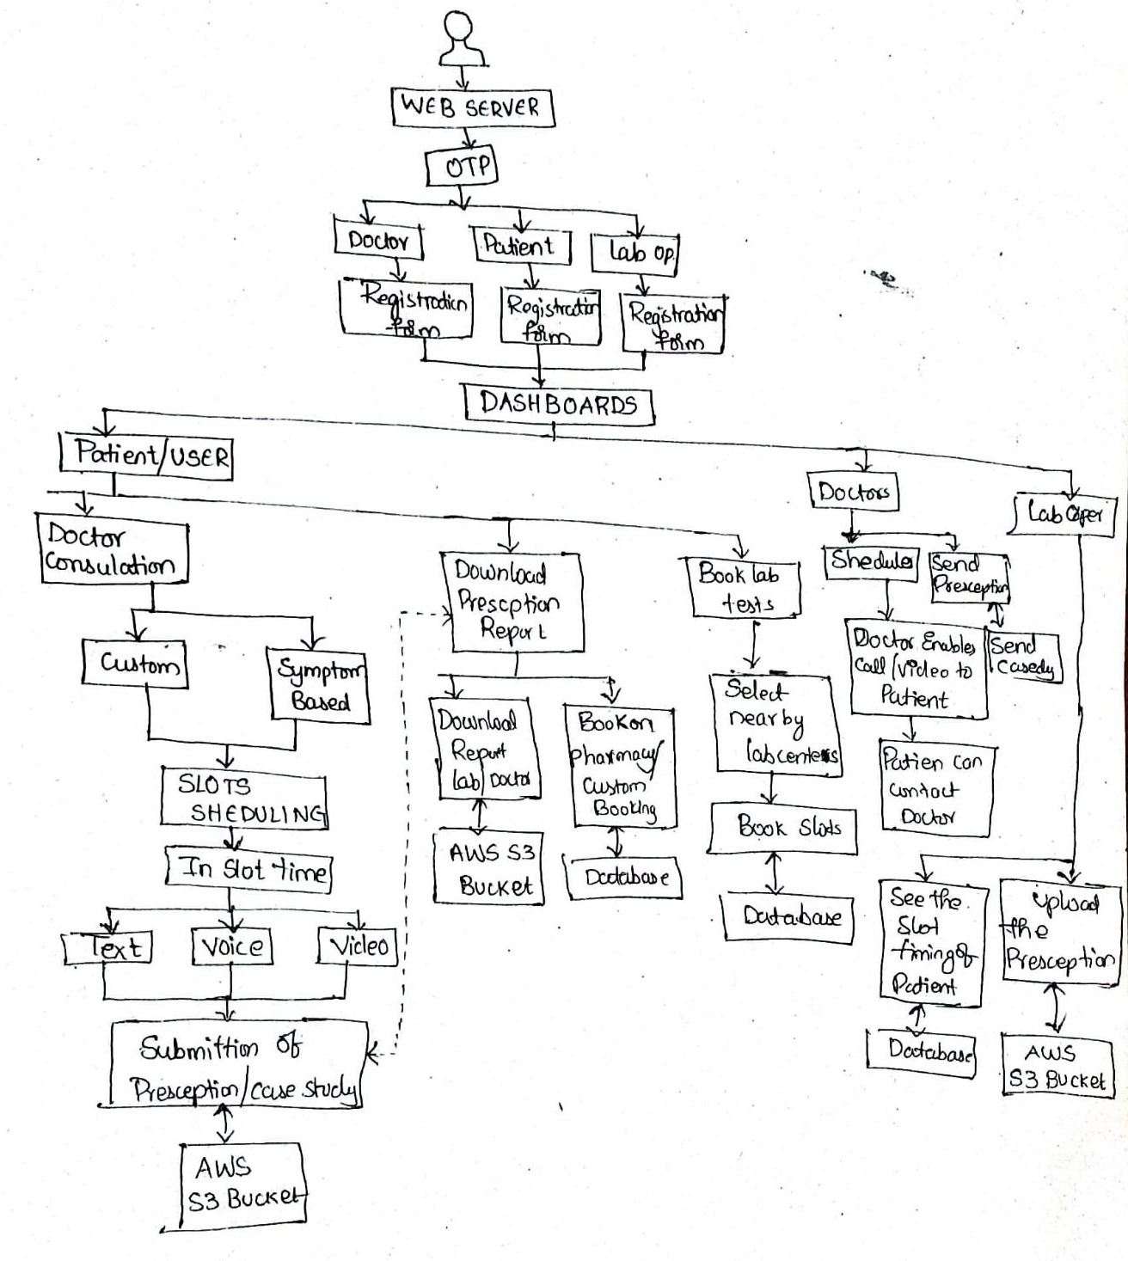
FLOW OF PROJECT

